Slide 1
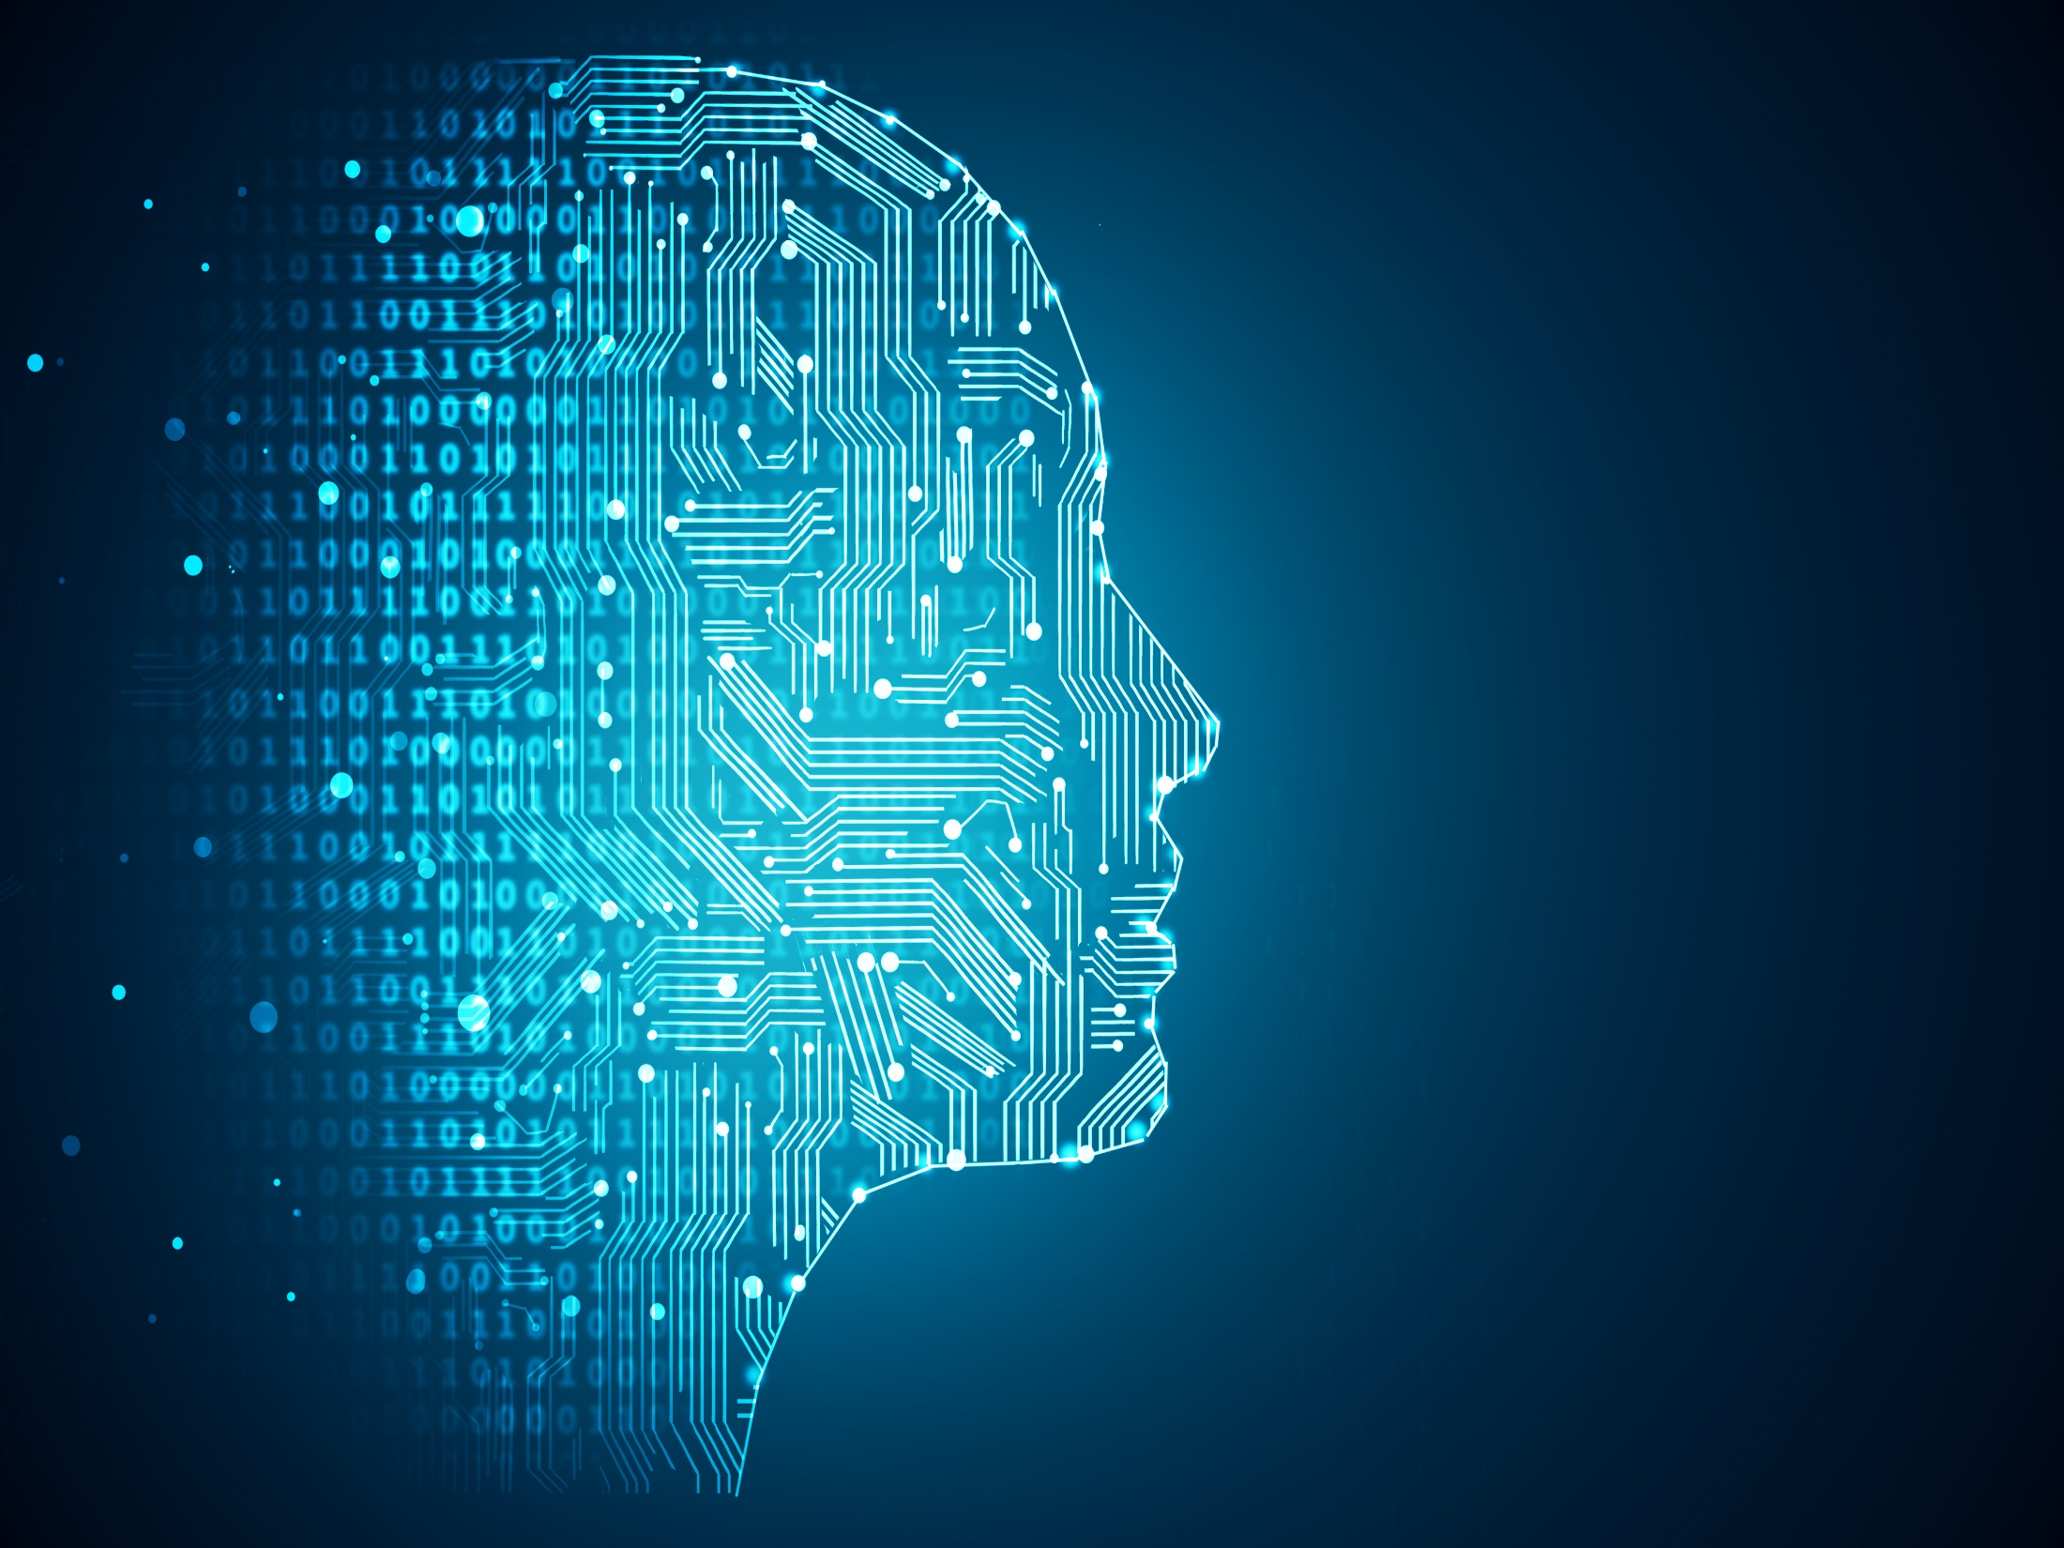
GESTURE RECOGNITION
BY
Indranil Kundu
&
Argha Dutta
Under the guidance of
Ms. Subarna Sen
BSc(H) Computer Science,
Surendranath College

Slide 2

INDEX
History
System Design
Algorithm
Types of gestures
Introduction
Image Dataset
Importing libraries
Image Data Generating
What is CNN?
Why CNN is better than SVM?
Model Building
Model Fitting
Prediction
Gesture Detection
Applications
Proposal
Future Scope
References

Slide 3
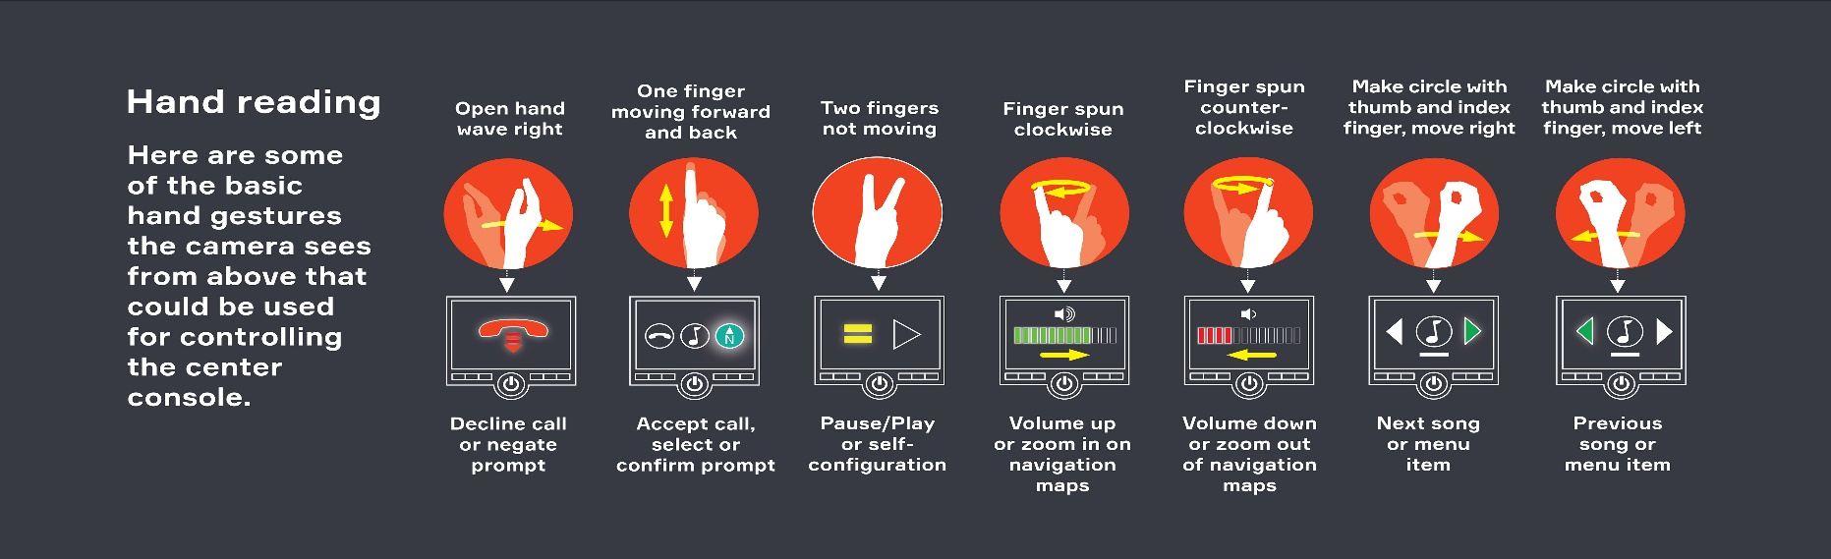
INTRODUCTION
Hand gesture’s are the changes in someone’s palm and fingers:-
i. Important part of nonverbal communication,
ii.Medical help
iii. Input to PC
Image source- www.ResearchGate.com

Slide 4
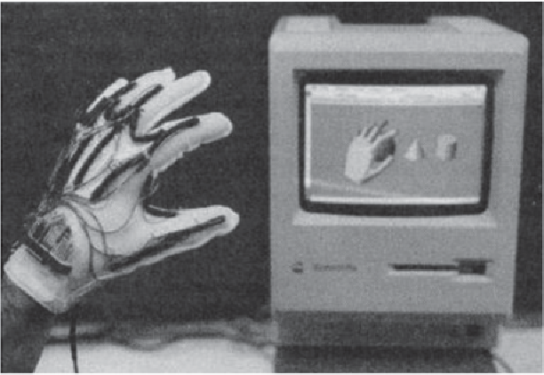
HISTORY
The history of hand gesture recognition started with the invention of glove-based control interfaces.
Gestures inspired by sign language can be used to offer simple commands for a computer interface.
Over the past 25 years, this evolution has resulted in many successful products that offer total wireless connection.
Image source- www.link.Springer.com

Slide 5
SYSTEM DESIGN
FLOW DIAGRAM
IMAGE
DATASET
IMAGE DATA GENERATION
MODEL CREATION
RECOGNISED GESTURE
PREDICTION
MODEL FITTING

Slide 6
PROCEDURE
Download the image dataset.
Access the dataset in Google Colab.
Generate the train and test images using . ImageDataGenerator.
Created the model with input,hidden and output layers.
The model is then fitted with train and test set of images.
Then predict the gesture of an image using the model.
Then the output image is displayed with the predicted gesture on the image.

Slide 7
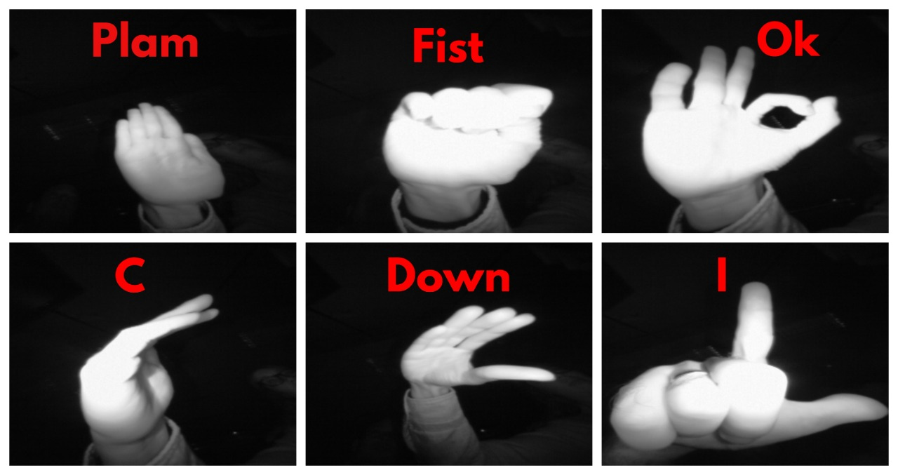
TYPES OF GESTURES
The following six gestures have been used:
Palm
Fist
Ok
C
Down
I

Slide 8
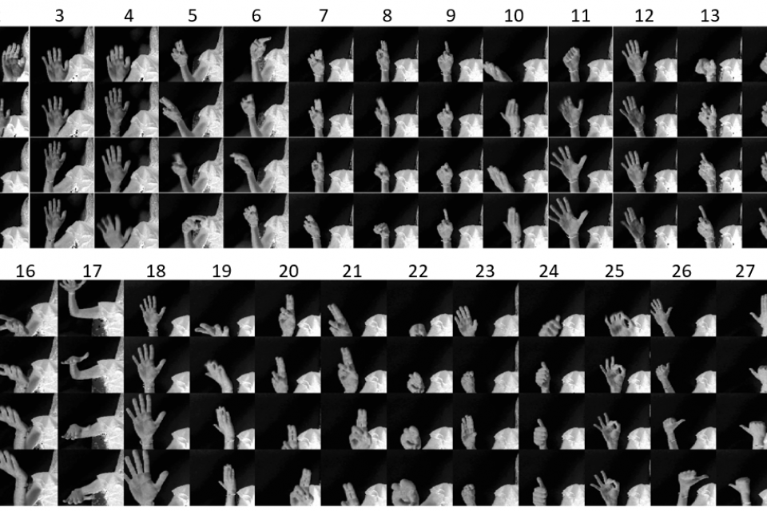
IMAGE DATASET
The image dataset was downloaded ‘Hand Gesture Recognisation Dataset’ . The dataset was uploaded in google drive.
Mount the drive in google colab to access the dataset.
Image source- www.Kaggle.com

Slide 9

IMPORTING LIBRARIES
A program must import a library module before using it.
Different libraries like opencv , numpy , tensorflow,Keras and many more as needed was used in the program.
Image source- www.medium.com

Slide 10
IMAGE DATA GENERATING
It generates batches of tensor image data with real-time data augmentation and applies a transformation to an image according to given parameters.
ImageDataGenerator was used to generate train and test images.
DATA
TRAIN
CLASS –A1
CLASS-B1
TEST
CLASS-A2
CLASS-B2

Slide 11
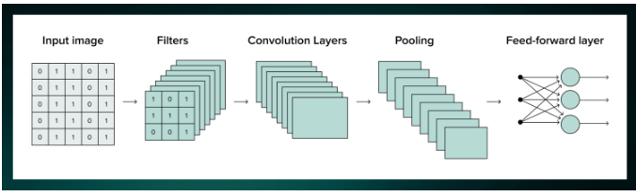
WHAT IS CNN?
A CNN(Convolutional Neural Network) is a deep learning method that can take an image as input, assign importance to distinct aspects/objects in the image and distinguish one from the other.
The goal of CNN is to reduce the images so that it would be easier to process without losing features that are valuable for accurate prediction.
Image source- www.upgrad.com
11

Slide 12
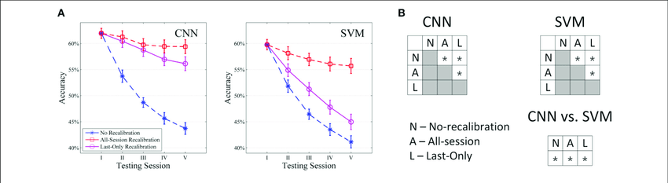
Why CNN is better than SVM?
CNN has a high performance with image recognition.It turned the manual feature extraction into automated process.
CNN can be performed well while dataset is big because CNN requires large dataset to train the system. SVM is able to train system by small dataset.
Image source- www.researchgate.net
12

Slide 13
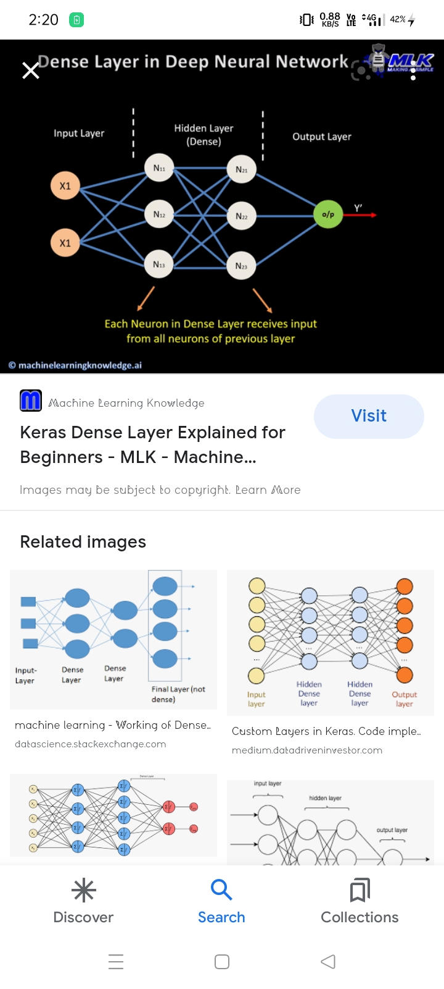
MODEL BUILDING
CNN is used here to build the model.
The model is sequential.
Three CNN layers were added.
Then a Flatten layer was added.
Followed by three fully connected dense layers.
Then the model was compiled.
Image source- www.javatpoint.com

Slide 14
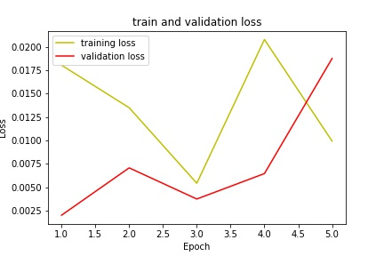
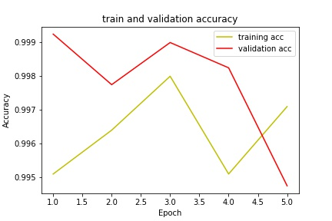
MODEL FITTING
It trains the model for a fixed number of epochs(iterations on the dataset).
The model was fitted with the training set and the test set.
Here the train accuracy is 99.71% and the validation accuracy is 99.48%.

Slide 15
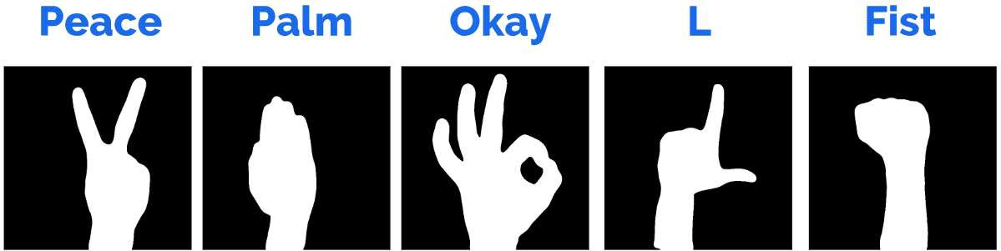
PREDICTION
Prediction of the image was made using image path of the saved image.
It predicts the gestures out of six gestures which are palm,fist,I,down,C,ok.

Slide 16
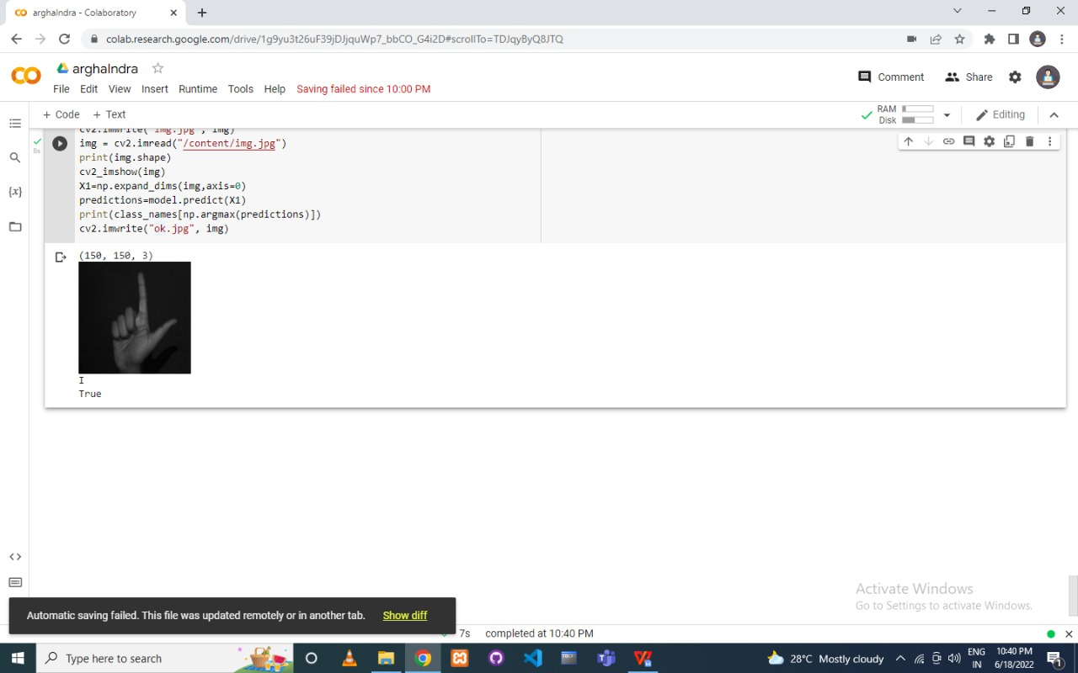
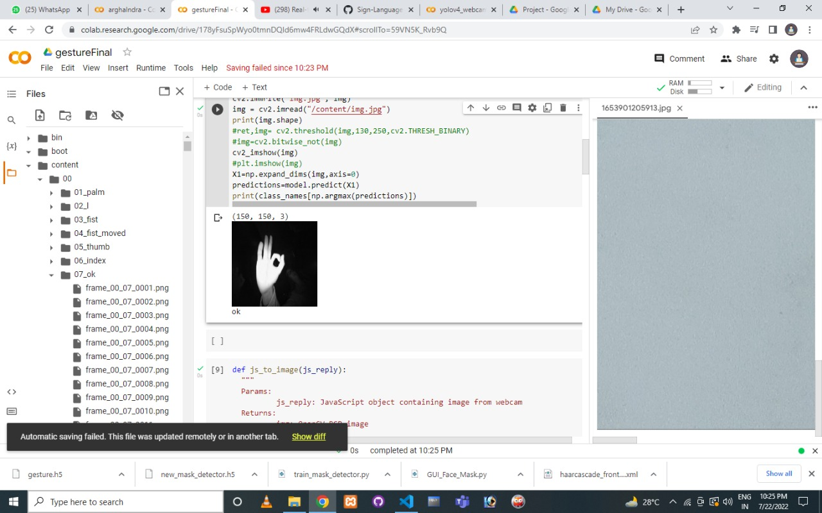
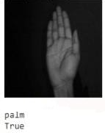
GESTURE DETECTION
The hand gestures are detected .
The end result is the image displayed with the predicted gesture.

Slide 17
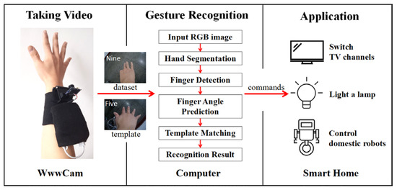
APPLICATIONS
It can help people talk with a computer.
It can be used in medical operations as well.
Disabled people who use there gestures are often not understood by normal people.
Image source- www.ResearchGate.com

Slide 18
PROPOSAL
For future work, a more robust gesture detection algorithm coupled with some good features can be researched to improve the results.
This system can be used in communication systems which can help a person ,in any form of expression to presents himself.
This system can also be used in medical field and a mode of interaction with the Computer.

Slide 19
Future Scope
Some features in our system can be added. Anyone can control many things in their PC using this. The idea is to recognise it and apply it as input to the computer.
Another improvement would be to enhance the recognition capacity for various lightning conditions, which is encountered as a challenge in this project can be worked upon in future.

Slide 20
REFERENCES
Oudah, Munir, Ali Al-Naji, and Javaan Chahl. "Hand gesture recognition based on computer vision: a review of techniques." journal of Imaging 6.8 (2020): 73.
Yasen, Mais, and Shaidah Jusoh. "A systematic review on hand gesture recognition techniques, challenges and applications." PeerJ Computer Science 5 (2019): e218.
Narayana, Pradyumna, Ross Beveridge, and Bruce A. Draper. "Gesture recognition: Focus on the hands." Proceedings of the IEEE conference on computer vision and pattern recognition. 2018.
Miao, Qiguang, et al. "Multimodal gesture recognition based on the resc3d network." Proceedings of the IEEE International Conference on Computer Vision Workshops. 2017.
Li, Gongfa, et al. "Dynamic gesture recognition in the internet of things." IEEE Access 7 (2018): 23713-23724.
Li, Gongfa, et al. "Hand gesture recognition based on convolution neural network." Cluster Computing 22.2 (2019): 2719-2729.
Maghoumi, Mehran, and Joseph J. LaViola. "DeepGRU: Deep gesture recognition utility." International symposium on visual computing. Springer, Cham, 2019.
Konar, Amit, and Sriparna Saha. "Gesture recognition." Principles, Techniques and Applications., Cham: Springer International Publishing (2018).
Sun, Jing-Hao, et al. "Research on the hand gesture recognition based on deep learning." 2018 12th International symposium on antennas, propagation and EM theory (ISAPE). IEEE, 2018.

Slide 21
THANK
YOU

